Slide 1
UNIT-III
FUNCTIONS

Slide 2
Definition:
A function is a block of code which only runs when it is called. (Or) A function is a self contained block of statements to solve a particular problem.
A program can be divided into several subprograms. Each sub program is a function.
The process of dividing a program several subprograms is nothing but MODULAR PROGRAMMING.
You can pass data, known as parameters, into a function.
A function can return data as a result.

Slide 3
Advantages of Functions:
Reusability of Code
Remove Redundancy
Decrease Complexity
Debugging Easy
Types of function:
There are two types of functions:
Standard Library Functions - Built-in Functions
Example: abs(), float(), all(), eval() etc
2. User-defined Functions - functions created by the user
Example: display()

Slide 4
Here are simple rules to define a function in Python.
1) Function blocks begin with the keyword def followed by the function name and parentheses ( ).
2) All input parameters/arguments should be placed within parentheses.
3) The first statement of a function can be an optional statement - the documentation string of the function or docstring.
4) The code block within every function starts with a colon (:) and is indented.
5) The statement return [expression] exits a function optionally passing back an expression to the caller (back to Calling function).

Slide 5

Syntax:
def function_name( parameters):
"function_docstring"
Bunch of statements
return [expression]
Ex-1:
def add(x):
x = x+2
a=10
b=20
C=30
print("Before....", a, b, c)
add(a)
add(b)
add(c)
print("After...", a, b, c)
Note: A function can return more than one value in Python.
Ex: return a, b, c. Here the values are returned as a TUPLE.

Slide 6
Flow of Control
....................
...................
Func1 ()
..................
...................
def Func1 ():
#function code
..................
...................
..................
Calling a function & Called Function
def fun1 ():
.........
.........
Fun2()
..........
def fun2 ():
.........
.........
Fun3()
..........
def fun3 ():
.........
.........
Fun4()
..........
def fun4 ():
.........
.........
.........
.........

Slide 7
Ex-2: Returning a Single value
def factorial(n):
f = 1
for i in range(1,n+1):
f = f*i
return f
num = int(input("Enter any number"))
print("factorial = ", factorial(num))
Ex-3: Returning Multiple Values
def arithmetic_op(a, b):
c=a+b
d = a-b
e = a*b
f = a/b
return c,d,e,f
result = arithmetic_op(6,8)
for i in result:
print(i, end=’,’)

Slide 8
Ex-4: List as Argument:
def update_sal(list):
for i in range(len(list)):
list[i] = int(list[i]) * 0.5
list = [20000,22000,30000,24000, 42000]
print("before.....")
for i in list:
print(i, end=" ")
update_sal(list)
print("after.....")
for i in list:
print(i, end=" ")
Output:
before..... 20000 22000 30000 24000 42000
after..... 10000.0 11000.0 15000.0 12000.0 21000.0

Slide 9
def func(d):
for key in d:
print("key:", key, "Value:", d[key])
# Driver's code
D = {'a':1, 'b':2, 'c':3}
func(D)

Slide 10
Types of Arguments – Python……
Every function has certain data to be processed. The data that comes in & data that goes out of the function. Observe the code:
def sum(a, b): // Here a and b are formal parameters
c = a+b
print(c)
x = 10, y = 15
sum(x, y) // Here x and y are actual parameters/arguments
The actual arguments are 4 types in Python:
Positional Arguments
Keyword Arguments
Default Arguments
Variable Length Arguments
Data
Function
Data

Slide 11
Positional Arguments simply tell that, the order of the arguments while calling & defining the function must exactly same.
Ex:
def mydetails(name, course, year):
print("Hi.. I am ", name, " studying ", course, " and the year is ", year)
mydetails("Krishna", "B.Tech-CSE", 2)

Slide 12
Keyword Arguments are the parameters that are identified by their names.
For example:
def grocery(item, price):
print("Item Name….", item)
print("Item Price…..", price)
grocery(item="Sugar", price=76)
grocery(price=110, item = "Oil")

Slide 13
Default Arguments: During the definition of a function, the arguments can be assigned some value.
def calculate_sal(basic=2300, ta=0, da=0.5, hra=0.1)
Code:
def calculate_sal(basic=2300, ta=0, da=0.5, hra=0.1, tax=0):
grosssal = basic + (basic*ta) + (basic * da) + (basic *hra)
netsal = grosssal - (grosssal*tax)
print("Gross sal = ", grosssal)
print("Net sal = ", netsal)
calculate_sal()
calculate_sal(3000)
calculate_sal(4000,0.2,0.7,0.2,0.15)

Slide 14
Variable length Arguments – The programmer doesn’t know how many values a function will receive. In that case, no of arguments are not fixed.
def function_name(farg, *args)
Code:
def mysum(farg, *args):
s = 0
for i in args:
s += i
print("Sum of values are…=",s)
mysum(10, 20) // farg=2
mysum(10, 20, 30, 40) // farg = 4
mysum(11, 22, 33, 44, 55, 66) // farg = 6
Output:
Sum of values are…= 20
Sum of values are…= 90
Sum of values are…= 220

Slide 15
# Global & local variables. - To know the scope of the variable.
# How to use & where to use
total = 0; # here total is the global variable
def sum1( arg1, arg2 ):
total = arg1 + arg2; # Here total is local variable.
print ("Inside the function local total : ", total)
return total;
def diffe(arg1, arg2):
total = arg1-arg2;
print ("Inside the function local total : ", total)
return total;
sum1( 10, 20 );
print ("Outside the function global total : ", total)
diffe( 40, 20 );
print ("Outside the function global total : ", total)
Inside the function local total : 30
Outside the function global total : 0
Inside the function local total : 20
Outside the function global total : 0

Slide 16
Assessment
A function in Python can return more than one value (True/False)
How many types of arguments are there in Python?
Lambda function map() and filter() to handle lists (True/False)

Slide 17
Anonymous Functions

Slide 18
- In Python, an anonymous function is a function that is defined without a name.
- Unlike normal function, anonymous functions prefix lambda keyword.
- So, anonymous functions are also called lambda functions.
- A lambda function can take any number of arguments, but can only have one expression.
- An anonymous function is like a macro in C & Inline function in C++.
- They are like instant functions for simple & short operations. ( Especailly used in Sorting & Filtering Data).

Slide 19
Anonymous function = Lambda Expression
Syntax:
Lambda arguments : Expression
Here the expression is executed and the result will be returned.
Regular Function &Anonymous Functions
def f(x):
return 2*x+3
k = lambda x : 2*x+3
print( f(4))
print(k(4))

Slide 20
Example#2: A lambda function that adds 10 to the number passed in as an argument, and print the result:
x = lambda a : a + 10
print(x(5))
Example#3:
full_name = lambda first, last: f'Full name: {first.title()} {last.title()}'
full_name('guido', 'van rossum')
Output: 'Full name: Guido Van Rossum'

Slide 21
A lambda Function can be any number of arguments.
Lambda x : Expression
Lambda x, y : Expression
Lambda x, y, z : Expression
.......................
Example: A lambda function that multiplies argument a with argument b and print the result:
x = lambda a, b : a * b
print(x(5, 6))

Slide 22
Lambda Functions using map() Function:
import math
def area(p):
return math.pi*p*p
x = [1,2,3,4,5]
areas = []
for i in x:
a = area(i)
areas.append(a)
print(x)
print(areas)
import math
def area(p):
return math.pi*p*p
x = [1,2,3,4,5]
areas = []
areas = list(map(area,x))
print(x)
print(areas)
import math
x = [1,2,3,4,5]
areas = []
areas = list(map(lambda p: math.pi * p*p, x))
print(x)
print(areas)

Slide 23
Example:
L = [1, 2, 3, 4]
P = list(map(lambda x: x**2, L))
print(L)
print(P)
Output:
[1,2,3,4]
[1,4,9,16]

Slide 24
Using lambdas with filter
As the name suggests, filter is another built-in function that actually filters a sequence or any iterable object. In other words, given any list, the filter function filters out some of the elements while keeping some based on some criteria.
For example, let’s define a very simple function that returns True for even numbers and False for odd numbers:
def even_fn(x):
if x % 2 == 0:
return True
return False
l= [1, 3, 2, 5, 20, 21]
print(list(filter(even_fn, l))
Output: [2,20]

Slide 25
Here a regular function is converted into lambda as follows:
even_fn = lambda x: x%2==0
l = [1, 3, 2, 5, 20, 21]
p = (list(filter(even_fn, l)))
print(p)

Slide 26
Sorting a list with a lambda expression sorts the list with the lambda expression as the key for the sort comparison. For example, sorting a list: [("Apples", 5, "20"), ("Pears", 1, "5"), ("Oranges", 6, "10")]
--------------------------------------------------------------------------------------------------------------------------
data = [("Apples", 5, "20"), ("Pears", 1, "5"), ("Oranges", 6, "10")]
data.sort(key=lambda x:x[0])
print(data) // OUTPUT: [('Apples', 5, '20'), ('Oranges', 6, '10'), ('Pears', 1, '5')]
----------------------------------------------------------------------------------------------------------------------------data.sort(key=lambda x:x[1])
print(data) // OUTPUT: [('Pears', 1, '5'), ('Apples', 5, '20'), ('Oranges', 6, '10')]
----------------------------------------------------------------------------------------------------------------------------data.sort(key=lambda x: int(x[2]))
print(data) // OUTPUT: [('Pears', 1, '5'), ('Oranges', 6, '10'), ('Apples', 5, '20')]

Slide 27
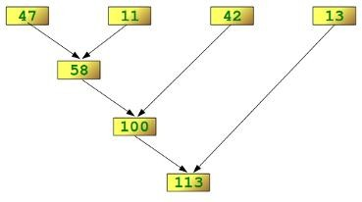
Reducing a List
The function reduce(func, seq) continually applies the function func() to the sequence seq. It returns a single value.
If seq = [ s₁, s₂, s₃, ... , s_{n} ], calling reduce(func, seq) works like this:
At first the first two elements of seq will be applied to func, i.e. func(s₁,s₂) The list on which reduce() works looks now like this: [ func(s₁, s₂), s₃, ... , s_{n} ]
In the next step func will be applied on the previous result and the third element of the list, i.e. func(func(s₁, s₂),s₃). The list looks like this now: [ func(func(s₁, s₂),s₃), ... , s_{n} ]
Continue like this until just one element is left and return this element as the result of reduce()
We illustrate this process in the following example:
>>> reduce(lambda x,y: x+y, [47,11,42,13])
Examples of reduce ( )
Determining the maximum of a list of numerical values by using reduce:
>>> f = lambda a,b: a if (a > b) else b
>>> reduce(f, [47,11,42,102,13])
102
>>>
Calculating the sum of the numbers from 1 to 100:
>>> reduce(lambda x, y: x+y, range(1,101)) 5050

Slide 28
Function Generators:
A generator is a function that produces a sequence of results instead of a single value. “yield‟ statement is used to return the value.
def mygen(n):
i = 0
while i < n:
yield i
i += 1
g=mygen(6)
for i in g:
print i,
Output:
0 1 2 3 4 5
Note: “yield‟ statement can be used to hold the sequence of results and return it.

Slide 29
Recursive Functions:
A function that calls itself is known as „recursive function‟. For example, we can write the factorial of 3 as:
factorial(3) = 3 * factorial(2) Here, factorial(2) = 2 * factorial(1) And, factorial(1) = 1 * factorial(0)
Now, if we know that the factorial(0) value is 1, all the preceding statements will evaluate and give the result as:
factorial(3) = 3 * factorial(2)
= 3 * 2 * factorial(1)
= 3 * 2 * 1 * factorial(0)
= 3 * 2 * 1 * 1
= 6
From the above statements, we can write the formula to calculate factorial of any number „n‟ as: factorial(n) = n * factorial(n-1)

Slide 30
Example-1:
def factorial(n):
if n==0:
result=1 else:
result=n*factorial(n-1) return result
for i in range(1,5):
print "factorial of ",i,"is",factorial(i)
Output:
factorial of 1 is 1
factorial of 2 is 2
factorial of 3 is 6
factorial of 4 is 24

Slide 31
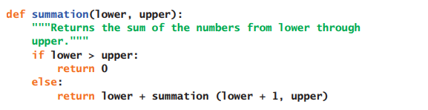
Examples
def displayRange(lower, upper):
"""Outputs the numbers from lower through upper."""
if lower <= upper:
print(lower)
displayRange(lower + 1, upper)

Slide 32
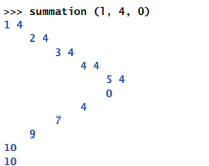
Tracing a Recursive Function
def summation(lower, upper, margin):
"""Returns the sum of the numbers from lower through upper,
and outputs a trace of the arguments and return values
on each call""“
blanks = " " * margin
print(blanks, lower, upper)
if lower > upper:
print(blanks, 0)
return 0
else:
result = lower + summation(lower + 1, upper, margin + 4)
print(blanks, result)
return result

Slide 33
Using Recursive Definitions to Construct Recursive Functions
Fib(n) = 1, when n = 1 or n = 2
Fib(n) = Fib(n - 1) + Fib(n - 2), for all n > 2
def fib(n):
"""Returns the nth Fibonacci number."""
if n < 3:
return 1
else:
return fib(n - 1) + fib(n - 2)

Slide 34
Recursion in Sentence Structure
def nounPhrase():
"""Returns a noun phrase, which is an article followed by a noun, and an optional prepositional phrase."""
phrase = random.choice(articles) + " " + random.choice(nouns)
prob = random.randint(1, 4)
If prob == 1:
return phrase + " " + prepositionalPhrase()
else:
return phrase
def prepositionalPhrase():
"""Builds and returns a prepositional phrase."""
return random.choice(prepositions) + " " + nounPhrase()

Slide 35
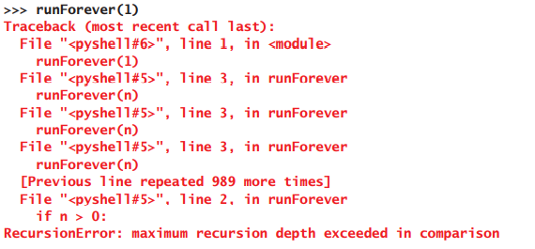
Infinite Recursion
def runForever(n):
if n > 0:
runForever(n)
else:
runForever(n - 1)

Slide 36
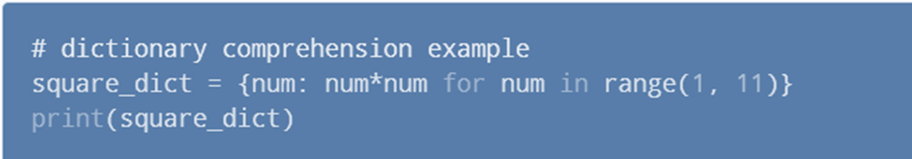
Using Dictionary Comprehension
dictionary = {key: value for vars in iterable}
#item price in dollars
old_price = {'milk': 1.02, 'coffee': 2.5, 'bread': 2.5}
dollar_to_pound = 0.76
new_price = {item: value*dollar_to_pound for (item, value) in old_price.items()}
print(new_price)
{'milk': 0.7752, 'coffee': 1.9, 'bread': 1.9}

Slide 37
Example : If Conditional Dictionary Comprehension
original_dict = {'jack': 38, 'michael': 48, 'guido': 57, 'john': 33}
even_dict = {k: v for (k, v) in original_dict.items() if v % 2 == 0}
print(even_dict)
{'jack': 38, 'michael': 48}
Example : Multiple if Conditional Dictionary Comprehension
original_dict = {'jack': 38, 'michael': 48, 'guido': 57, 'john': 33}
new_dict = {k: v for (k, v) in original_dict.items() if v % 2 != 0 if v < 40}
print(new_dict)
{'john': 33}

Slide 38
Example 6: if-else Conditional Dictionary Comprehension
original_dict = {'jack': 38, 'michael': 48, 'guido': 57, 'john': 33}
new_dict_1 = {k: ('old' if v > 40 else 'young') for (k, v) in original_dict.items()}
print(new_dict_1)
{'jack': 'young', 'michael': 'old', 'guido': 'old', 'john': 'young'}
Example 7: Nested Dictionary with Two Dictionary Comprehensions
dictionary = {
k1: {k2: k1 * k2 for k2 in range(1, 6)} for k1 in range(2, 5) }
print(dictionary)
{2: {1: 2, 2: 4, 3: 6, 4: 8, 5: 10}, 3: {1: 3, 2: 6, 3: 9, 4: 12, 5: 15}, 4: {1: 4, 2: 8, 3: 12, 4: 16, 5: 20}}

